Slide 1
Introduction to Electric and Electronics
Chapter 2 –
The Basic Laws of Circuit Analysis

Slide 2
Learning Objectives
Learning Objectives
To learn three basic laws:
Ohm’s Law
Kirchhoff’s Current Law(KCL)
Kirchhoff’s Voltage Law(KVL)
To understand current division and voltage division
To be able to simplify complicated resistor networks and reduce them to a single resistor
To be able to analyze simple networks containing both independent and dependent sources

Slide 3
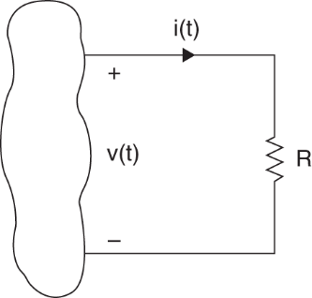
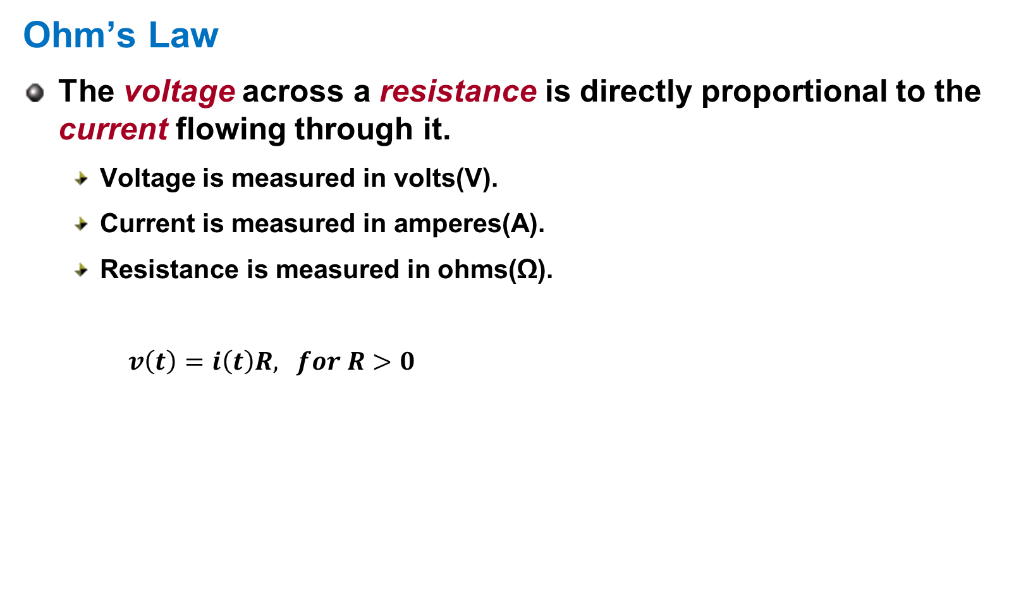
Ohm’s Law
Ohm’s Law
The voltage across a resistance is directly proportional to the current flowing through it.
Voltage is measured in volts(V).
Current is measured in amperes(A).
Resistance is measured in ohms(Ω).
$v\left(t\right)=i\left(t\right)R, for R>0$

Slide 4
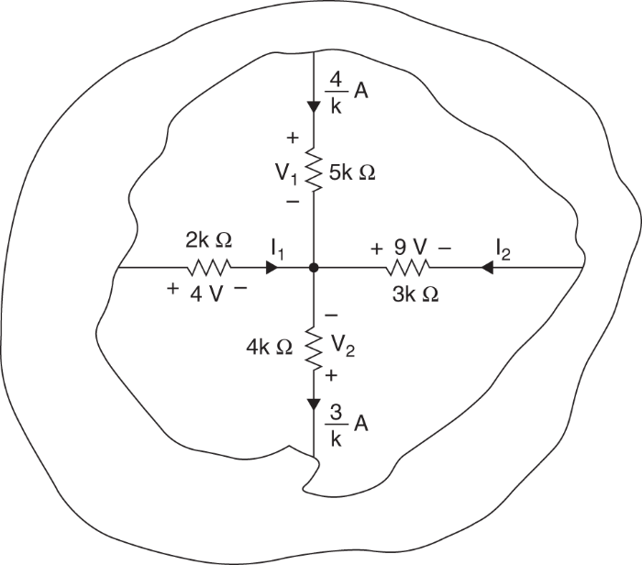
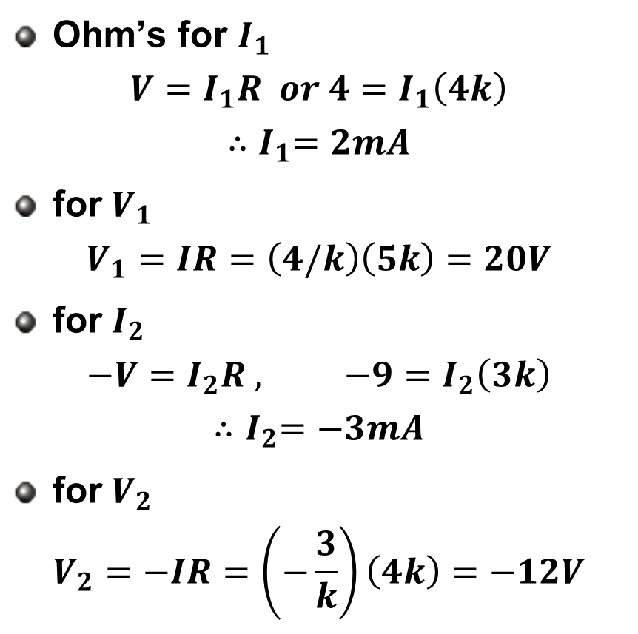
Ohm’s Law
Ohm’s for $I_{1}$
$$V=I_{1}R or 4=I_{1}\left(4k\right)$$
$${∴I}_{1}=2mA$$
for $V_{1}$
$$V_{1}=IR=\left(4/k\right)\left(5k\right)=20V$$
for $I_{2}$
$$−V=I_{2}R , −9=I_{2}\left(3k\right)$$
$${∴I}_{2}=−3mA$$
for $V_{2}$
$$V_{2}=−IR=\left(−\frac{3}{k}\right)\left(4k\right)=−12V$$

Slide 5
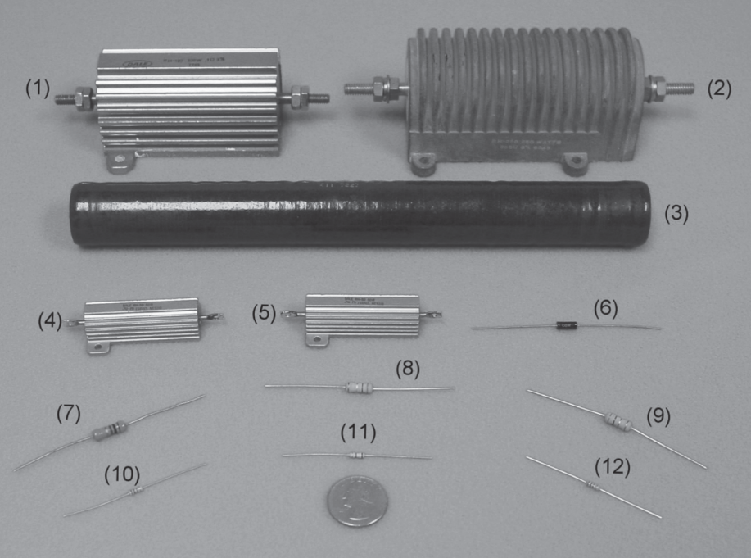
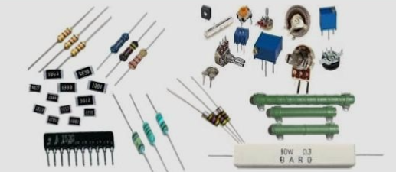
Ohm’s Law
Resistivity
Materials tend to resist the flow of electricity through them.
This property is called “resistance.”
The resistance of an object is a function of its length, l, and cross sectional area, A, and the material’s resistivity:

Slide 6
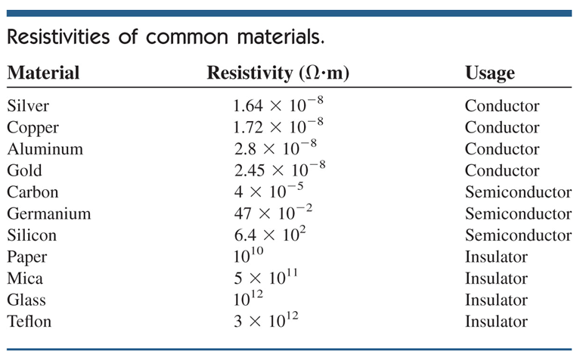
Ohm’s Law
Resistivity of Common Materials

Slide 7
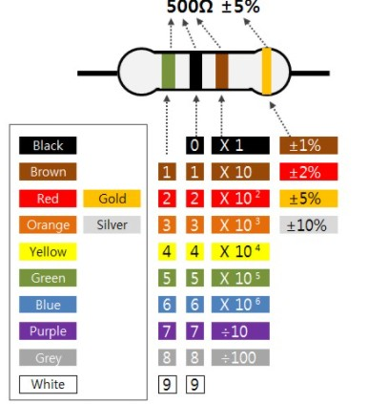
Ohm’s Law
Resistor Color Codes
To indicate the resistance values a series of colored bands is used.

Slide 8

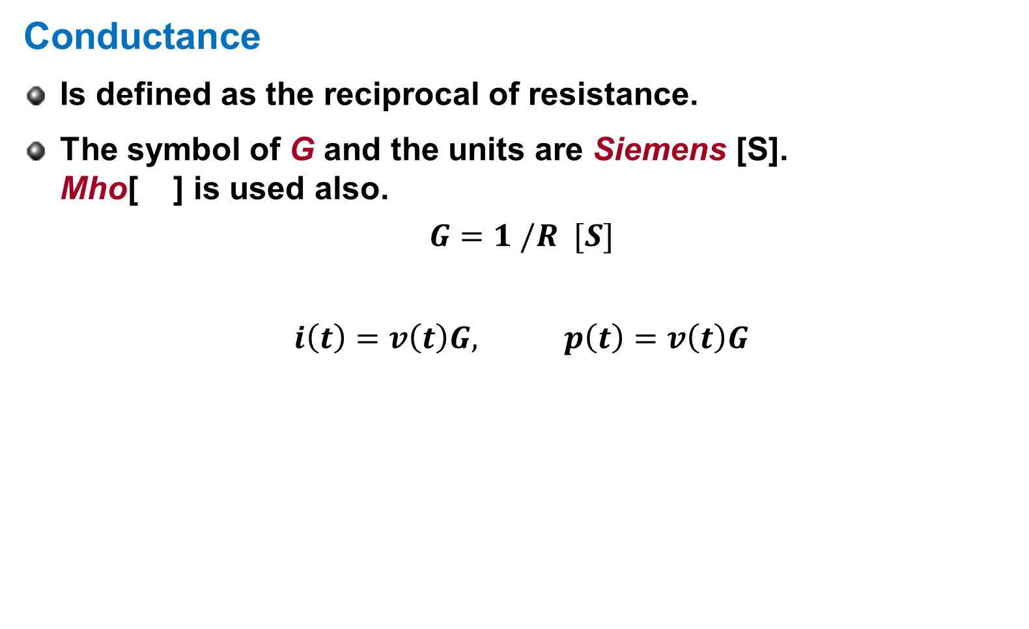
Ohm’s Law
Conductance
Is defined as the reciprocal of resistance.
The symbol of G and the units are Siemens [S]. Mho[ ] is used also.
$$G=1 /R [S]$$
$$i\left(t\right)=v\left(t\right)G, p\left(t\right)=v\left(t\right)G$$

Slide 9
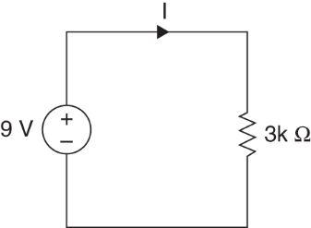
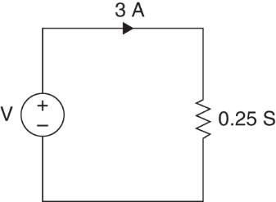
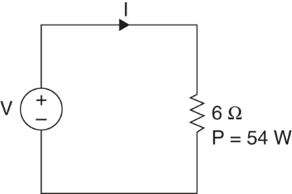
Examples
Example 2.1
Let us determine current and power
Example 2.2
Let us examine voltage and power
Example 2.3
Let us determine current

Slide 10
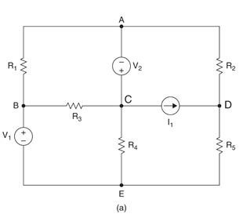
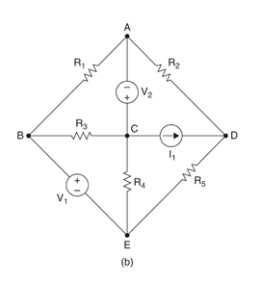
Kirchhoff’s Law
Node, loop, mesh, and branch
A node is the point of connection between two or more elements.
5 nodes, labeled A through E
A loop is any closed path through the network in which no node is traversed more than once.
ACEBA and BCDEB are loops and ACDECA is not a loop
A mesh is defined as a loop that does not contain another loop. “Windowpane”
ACDA and CDEC are meshes and ADECA is not a mesh
A branch is any element connected between two nodes.
8 branches.

Slide 11
Kirchhoff’s Law
Kirchhoff’s Laws
Ohm’s law is not sufficient for circuit analysis
Kirchhoff’s laws complete the needed tools
There are two laws:
Kirchhoff’s Current law (KCL)
Kirchhoff’s Voltage law (KVL)

Slide 12
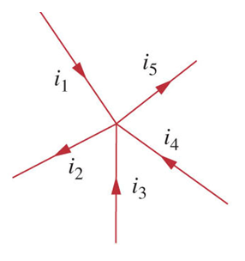
Kirchhoff’s Law
Kirchhoff’s Current Law (KCL)
Kirchhoff’s current law is based on conservation of charge
the algebraic sum of currents entering a node is zero.
the algebraic sum of currents leaving a node is zero.
the currents entering a node must be equal to the currents leaving the node.
It can be expressed as:

Slide 13
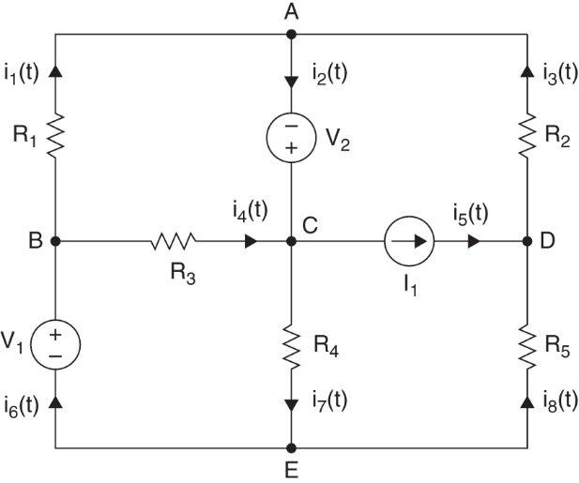
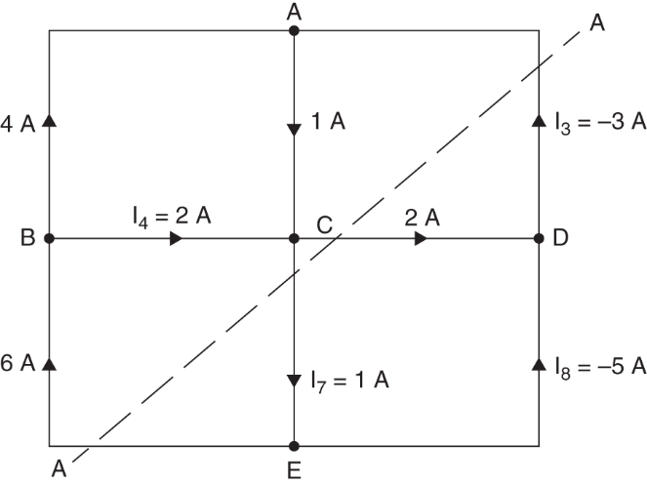
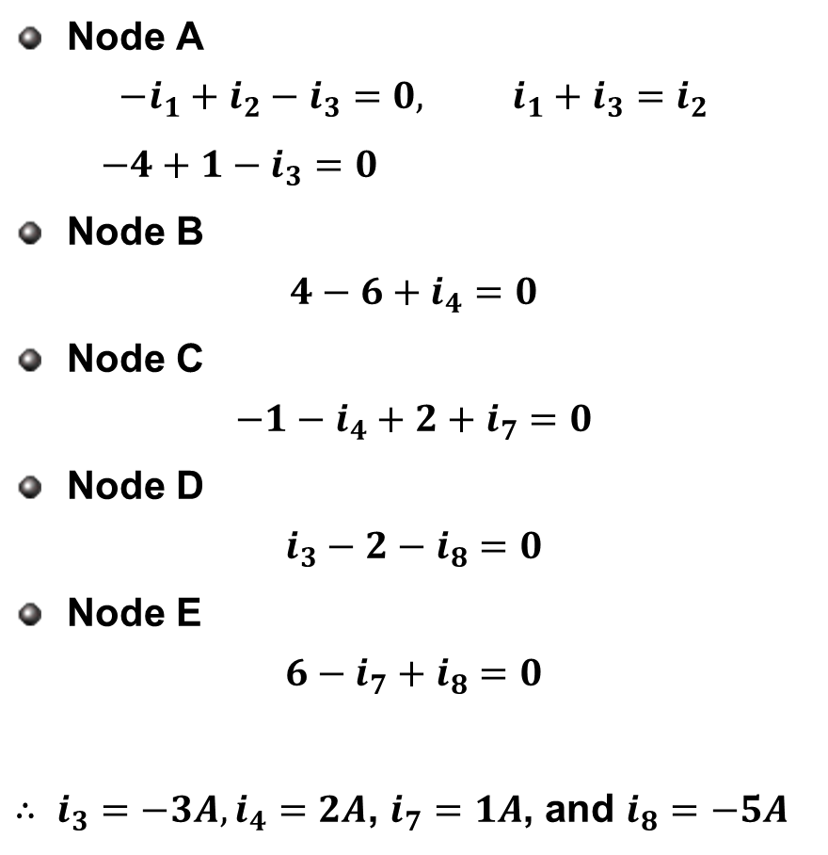
KCL, Example 2.4
Node A
$$−i_{1}+i_{2}−i_{3}=0, i_{1}+i_{3}=i_{2}$$
$−4+1−i_{3}=0$
Node B
$$4−6+i_{4}=0$$
Node C
$$−1−i_{4}+2+i_{7}=0$$
Node D
$$i_{3}−2−i_{8}=0$$
Node E
$$6−i_{7}+i_{8}=0$$
$∴ i_{3}=−3A,i_{4}=2A$, $i_{7}=1A$, and $i_{8}=−5A$

Slide 14
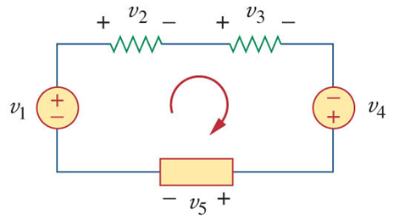
Kirchhoff’s Law
Kirchhoff’s Voltage Law (KVL)
Kirchhoff’s voltage law is based on conservation of energy
It states that the algebraic sum of voltages around any loop is zero.
It can be expressed as:

Slide 15
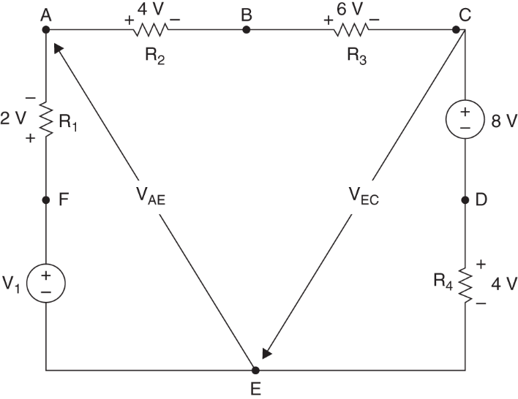

KVL, Example 2.5
Example 2.5
From node E, KVL equation is
$$−V_{1}+2+4+6+8=0, { ∴V}_{1}=24V$$
Determine $V_{AE}$
$−V_{1}+2+V_{AE}=0$, ${ ∴V}_{AE}=22V$
Determine $V_{EC}$
$V_{EC}+8+4=0$, ${ ∴V}_{EC}=−12V$

Slide 16
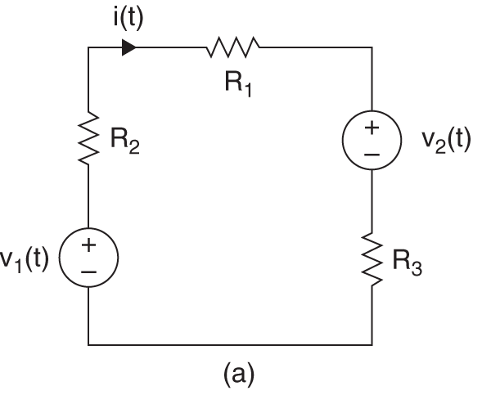
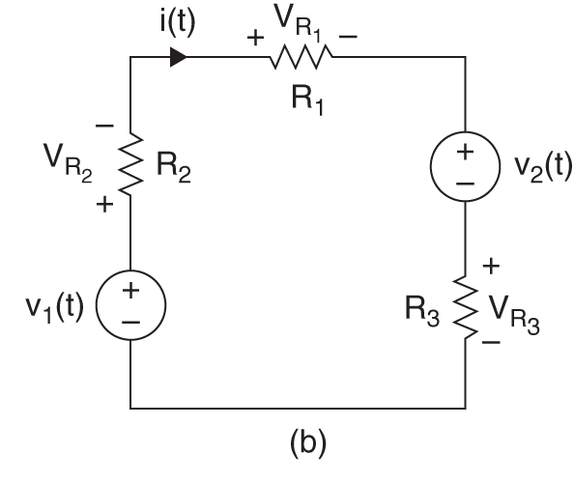
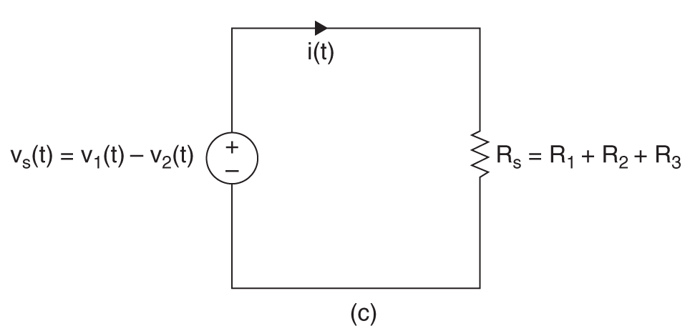

KVL, Single Loop Circuit
Single loop circuit
KVL ${−v}_{1}\left(t\right)+v_{R_{2}}+v_{R_{1}}{+v}_{2}\left(t\right)+v_{R_{3}}=0$ with Ohm’s Law ${−v}_{1}\left(t\right)+{i\left(t\right)R}_{2}{+{i\left(t\right)R}_{1}+v}_{2}\left(t\right)+{i\left(t\right)R}_{3}=0$
then $[{R_{1}+R}_{2}+R_{3}]i\left(t\right)=v_{1}\left(t\right)−v_{2}\left(t\right)$ or $i\left(t\right)R_{s}=v_{s}(t)$
where $R_{s}={R_{1}+R}_{2}+R_{3}$ and ${v_{s}\left(t\right)−v}_{1}\left(t\right)−v_{2}\left(t\right)$
Current ${∴ i\left(t\right)=v}_{s}(t)/R_{s}$

Slide 17
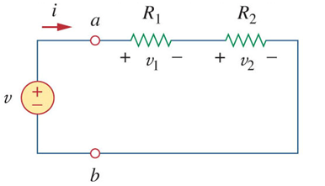
Series Resistors
Series Resistors
Resistors in series add, and voltage sources in series add algebraically.
In the circuit shown, applying Ohm’s law to both resistors;
If we apply KVL to the loop we have:
Combining the two equations:
From this we can see there is an equivalent resistance of the two resistors:
For N resistors in series:

Slide 18
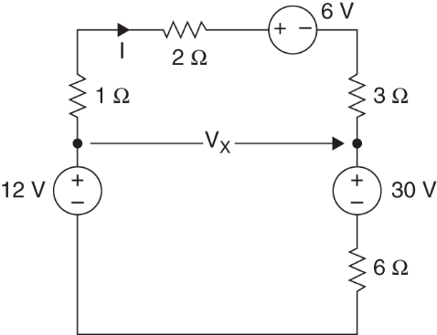
Example 2.6
Example 2.6
Let us determine current, voltage, and the power supplied or absorbed by each element.

Slide 19
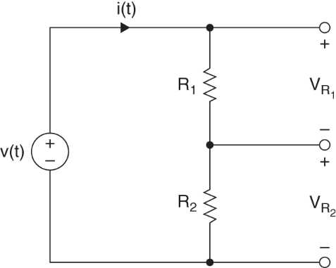
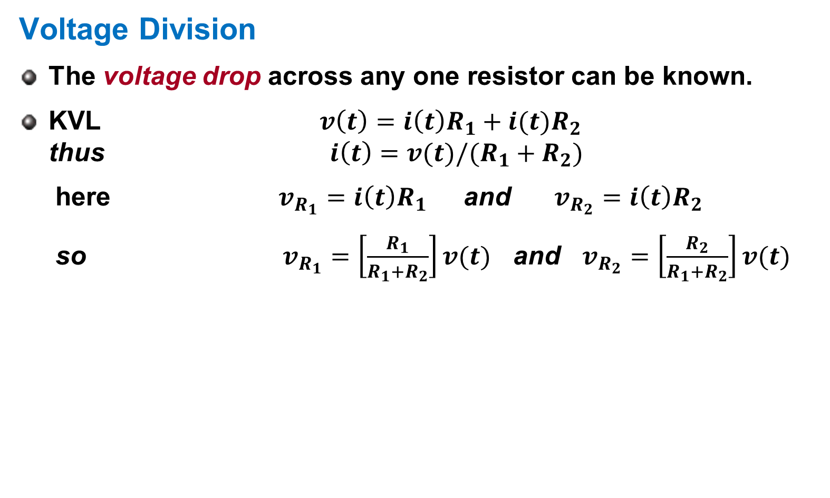
Voltage Division
Voltage Division
The voltage drop across any one resistor can be known.
KVL ${v\left(t\right)=i\left(t\right)R}_{1}+i(t)R_{2}$ thus ${i\left(t\right)=v(t)/(R}_{1}+R_{2})$
here $v_{R_{1}}=i\left(t\right)R_{1}$ and $v_{R_{2}}=i\left(t\right)R_{2}$
so $v_{R_{1}}=\left[\frac{R_{1}}{R_{1}+R_{2}}\right]v(t)$ and $v_{R_{2}}=\left[\frac{R_{2}}{R_{1}+R_{2}}\right]v(t)$

Slide 20
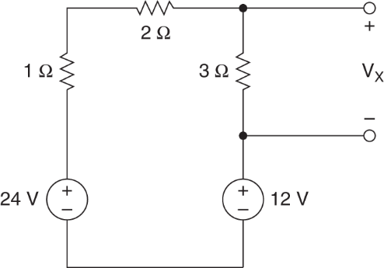
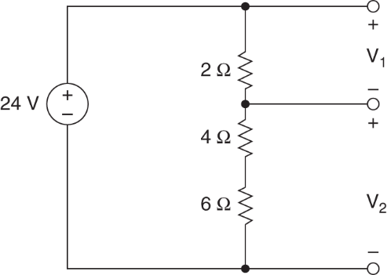


Examples
Example 2.7
Let us determine the voltage $v_{1}$ and $v_{2}$.
Example 2.8
Let us determine the voltage $v_{x}$.

Slide 21
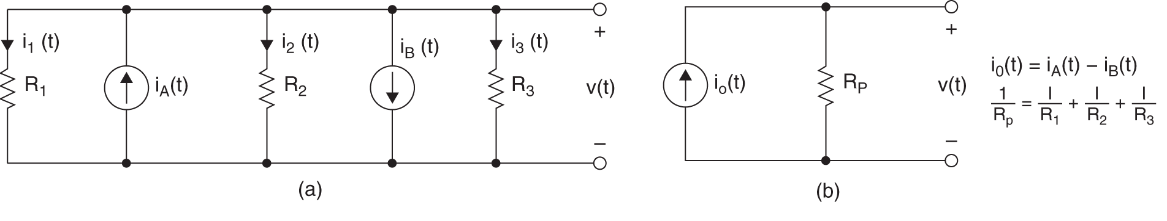
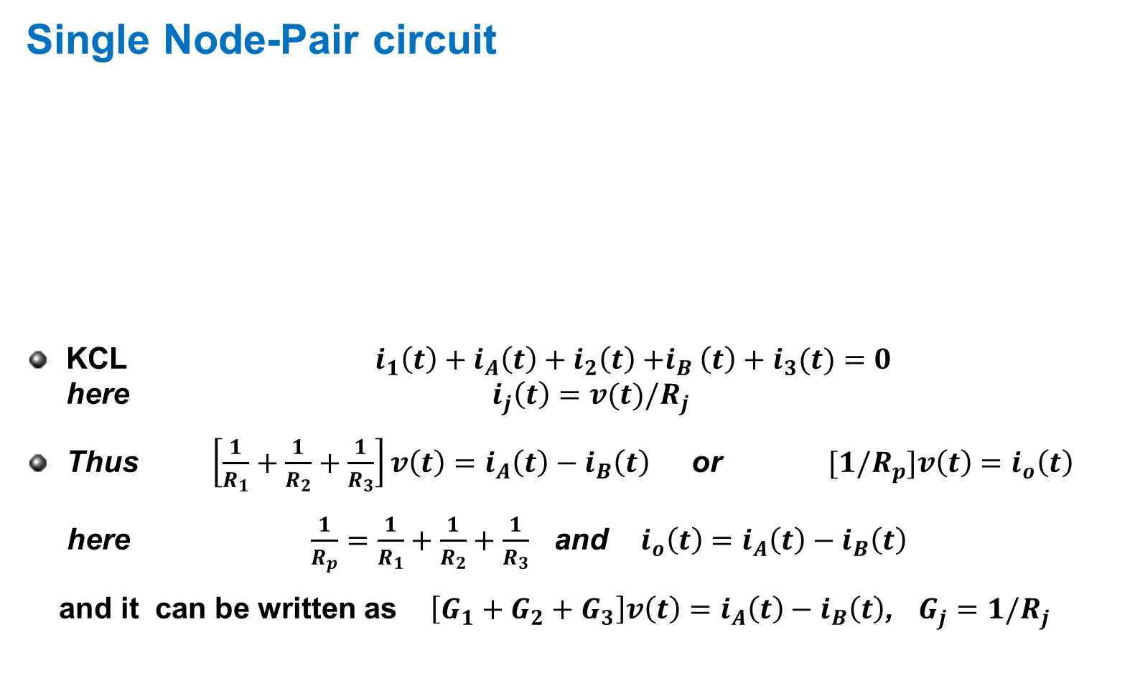
KCL, Single Node-Pair Circuit
Single Node-Pair circuit
KCL $i_{1}\left(t\right)+i_{A}\left(t\right)+i_{2}\left(t\right){+i}_{B}\left(t\right)+i_{3}(t)=0$ here $i_{j}\left(t\right)=v(t)/R_{j}$
Thus $\left[\frac{1}{R_{1}}+\frac{1}{R_{2}}+\frac{1}{R_{3}}\right]v\left(t\right)=i_{A}\left(t\right)−i_{B}\left(t\right)$ or ${[1/R}_{p}]v\left(t\right)=i_{o}\left(t\right)$
here $\frac{1}{R_{p}}=\frac{1}{R_{1}}+\frac{1}{R_{2}}+\frac{1}{R_{3}}$ and ${i_{o}\left(t\right)=i}_{A}\left(t\right)−i_{B}\left(t\right)$
and it can be written as $\left[G_{1}+G_{2}+G_{3}\right]v\left(t\right)=i_{A}\left(t\right)−i_{B}\left(t\right)$, $G_{j}=1/R_{j}$

Slide 22
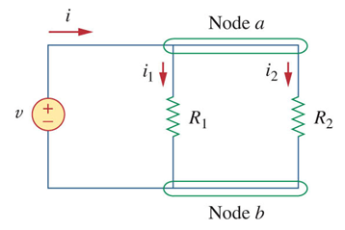

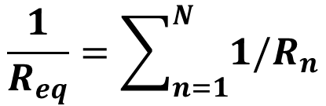
Parallel Resistors
Parallel Resistors
Conductors add in parallel and current source in parallel add algebraically
When resistors are in parallel, the voltage drop across them is the same
By KCL, the current at node a is:
The equivalent resistance is:
For N resistors in parallel:
or
$$\frac{1}{R_{eq}}=\sum_{n=1}^{N}{1/R_{n}}$$
$$G_{eq}=\sum_{n=1}^{N}{G_{n}}$$

Slide 23
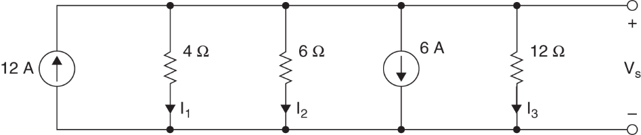

Example 2.9
Example 2.9
Let us determine current, voltage $V_{s}$, the current in each element, and the power supplied and absorbed in the network.

Slide 24
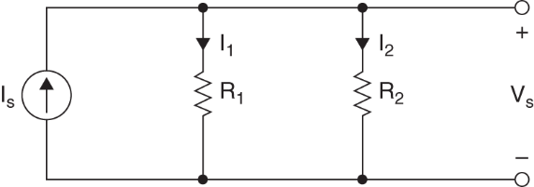
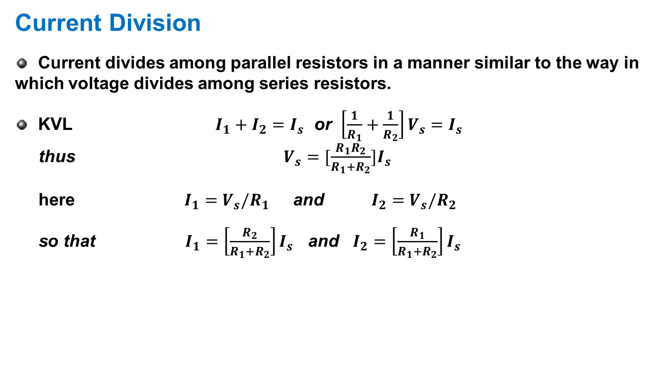
Current Division
Current Division
Current divides among parallel resistors in a manner similar to the way in which voltage divides among series resistors.
KVL $I_{1}+I_{2}=I_{s}$ or $\left[\frac{1}{R_{1}}+\frac{1}{R_{2}}\right]V_{s}=I_{s}$ thus $V_{s}=[\frac{R_{1}R_{2}}{R_{1}+R_{2}}]I_{s}$
here $I_{1}=V_{s}/R_{1}$ and $I_{2}=V_{s}/R_{2}$
so that $I_{1}=\left[\frac{R_{2}}{R_{1}+R_{2}}\right]I_{s}$ and $I_{2}=\left[\frac{R_{1}}{R_{1}+R_{2}}\right]I_{s}$

Slide 25
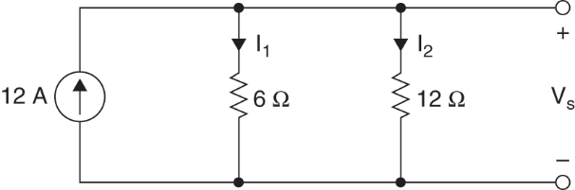
Example 2.10
Example 2.10
Let us calculate the current in the two resistors

Slide 26
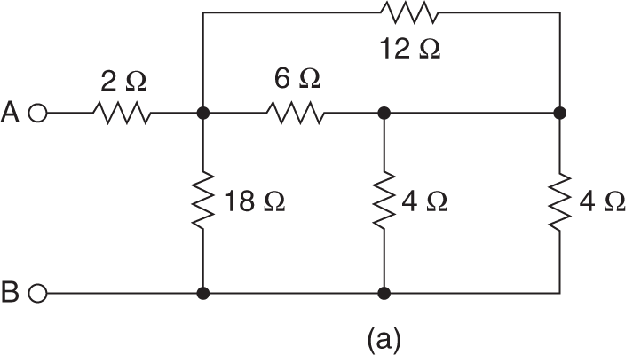
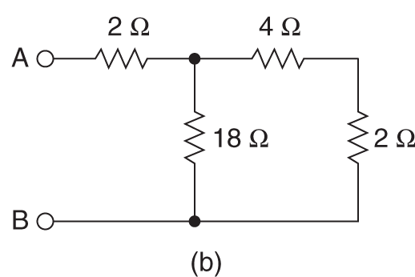


Resistor combinations
Resistor combinations
For N resistors in series
For N resistor in parallel
Example 2.11
$$R_{s}=\sum_{n=1}^{N}{R_{n}}$$
$$\frac{1}{R_{p}}=\sum_{n=1}^{N}{1/R_{n}}$$

Slide 27
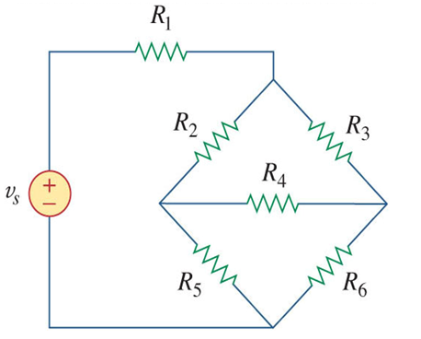
Wye-Delta Transformations
Wye-Delta Transformations
There are cases where resistors are neither parallel nor series
Consider the bridge circuit shown here
This circuit can be simplified to a three-terminal equivalent

Slide 28
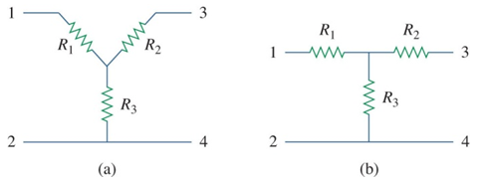
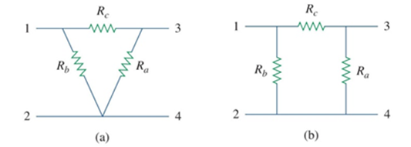
Wye-Delta Transformations
Wye-Delta Transformations II
Two topologies can be interchanged:
Wye (Y) or tee (T) networks
Delta (Δ) or pi (Π) networks
Transforming between these two topologies often makes the solution of a circuit easier

Slide 29

Wye-Delta Transformations
Wye-Delta Transformations III
The superimposed wye and delta circuits shown here will used for reference.
The delta consists of the outer resistors, labeled a, b, and c.
The wye network are the inside resistors, labeled 1, 2, and 3.

Slide 30

Wye-Delta Transformations
Delta to Wye
The conversion formula for a delta to wye transformation are:

Slide 31

Wye-Delta Transformations
Wye to Delta
The conversion formula for a wye to delta transformation are:

Slide 32

Example 2.13
Example 2.13
Let us determine the equivalent resistance at the terminals A-B for the network shown

Slide 33

Simple Network Analysis
Simple Network Analysis
Example 2.14
We wish to de determine the voltage and currents that are identified in this circuit

Slide 34

Example 2.15
Example 2.15
We want to find the value of the current source and the amount of power it supplies to the network.

Slide 35


Example 2.16
Example 2.16
Let us determine the value of the voltage source $V_{s}$ and the power absorbed or supplied to the network by this source.

Slide 36


Circuit with Dependent Sources
Circuit with Dependent Sources
Example 2.17
We wish to find the output voltage, $V_{o}$.

Slide 37


Example 2.18
Example 2.18
We wish to find the output voltage, $V_{o}$ and the power absorbed by 2k Ω resistor.

Slide 38
Homework
Homework
Solve Problems 2.35, 2.40, 2.48, 2.51, 2.55
Read Text Chapter 3.
Prepare Presentation

